Slide 2
Plugins and Brightcove Player
Matt Boles, Learning Specialist
mboles@brightcove.com or training@brightcove.com

Slide 3
Introducing the Course

Slide 4
What: Brightcove Player
The Brightcove Player is based on the Video.js Player
Three core elements:
Video embed code - Places a video into a website using the HTML5 <video> element falling back to Flash automatically
JavaScript library - Makes the player work across browsers, their various versions and around device / platform bugs
Pure HTML/CSS skin - Creates a uniform look across HTML5 browsers and easy custom skinning for a branded look

Slide 5
Adding a Brightcove Plugin to a Player

Slide 6
Plugins for Brightcove Player
A plugin for the Brightcove player uses a combination of HTML, JavaScript and/or CSS to somehow customize the player
In other words, anything you can do in a web page, you can do in a plugin
Broadly, plugins can be developed to
Modify default behavior
Add functionality
Customize appearance

Slide 7
Brightcove Supplied Plugins
Brightcove has released, and continues to release, plugins
Debugger
Display Thumbnail Previews
Errors
Google Analytics
HLS
IMA
OnceUX
Overlay
Social Media

Slide 8
Brightcove Plugins Loaded by Default
The following are plugins loaded by default
Debugger
Errors
HLS

Slide 9
Implementing Plugins Using Studio UI
One of three ways to use a plugin
Use the Studio UI to supply the plugin's
JavaScript
Name
Options (if needed)
CSS (if needed)
Plugin associated with ALL instances of the player

Slide 10
Implementing Plugins Using Custom Code
Second way use a plugin
Use a <script> tag to manually include the plugin's JavaScript
Use a <link> tag to manually include the plugin's CSS (if needed)
Call the plugin as a method, supplying required options
myPlayer.ima3({
serverUrl: "http://pubads.g.doubleclick.net/…"
});
Plugin associated ONLY with the instance of the player on the page
Provides flexibility, such as dynamically supplying options

Slide 11
Implementing Plugins Using curl Statements
Can configure the player, and associated plugins, using the Player Management API
Details on using curl not part of this course
curl --header "Content-Type: application/json" --user $EMAIL --request PATCH \
--data '{
"stylesheets": ["http://…/plugin-dev.css"
],
"scripts": ["http://…/plugin-dev.js"
],
"plugins": [{ "name": "pluginDev", "options": {"overlayText": "This …"}
}]
}' \
https://players.api.brightcove.com/v1/accounts/$ACCOUNT_ID/players /$PLAYER_ID/configuration

Slide 12
Demo 1: Adding the Overlay Plugin to a Player AND/OR Demo 2: Using the IMA Plugin to Play VAST Ads

Slide 13
Creating and Using a Plugin

Slide 14
Process for Creating and Using a Custom Plugin
Create the JavaScript for the plugin in a separate file
Create the CSS for the plugin in a separate file (if needed)
Add the CSS and JavaScript to your HTML page
From the player object, call the name of the plugin defined in the JavaScript
Create an options object, pass it to the plugin function definition and use (if needed)

Slide 15
Creating a Plugin with JavaScript
Brightcove Player plugins must follow a general format:
videojs.plugin('pluginName', function() {
var player = this;
//Any JavaScript, HTML and CSS
});
Can also pass options to the plugin

Slide 16
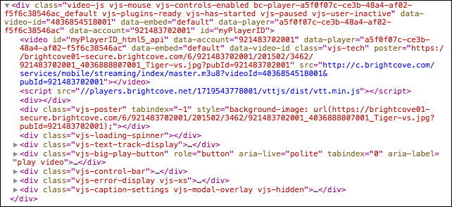
Used in Plugin: myPlayer.el() Method
Gets the player's DOM element (what the <video> tag is transformed into); HTML5 Version

Slide 17
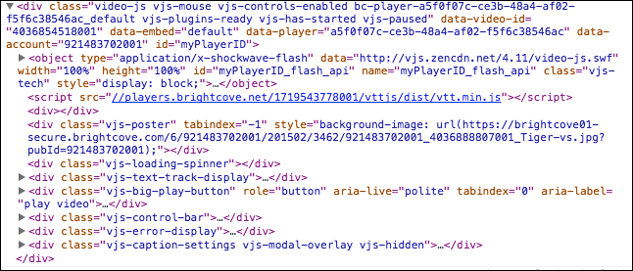
Used in Plugin: myPlayer.el() Method
Gets the player's DOM element (what the <video> tag is transformed into); Flash Version

Slide 18
JavaScript to Create Your Own Overlay
videojs.plugin('pluginDev', function() {
var player = this,
overlay = document.createElement('p');
overlay.className = 'vjs-overlay';
overlay.innerHTML = "Becoming a plugin expert";
player.el().appendChild(overlay);
});

Slide 19
CSS for Your Own Overlay
.vjs-overlay {
background-color: #333333;
color: white;
position: absolute;
}

Slide 20
Use Custom Plugin
<link href="demo7-plugin-solution.css" rel="stylesheet">
<script type="text/javascript" src="demo7-plugin-solution.js"></script>
<script type="text/javascript">
videojs('myPlayerID').ready(function(){
myPlayer = this;
this.pluginDev();
})
</script>

Slide 21
Demo 3: Creating an Overlay Plugin and Adding it to a Player (No Options)

Slide 22
Pass in Options to the Plugin
Create an options object that contains the desired data
Pass the object as a parameter to the plugin
Use the data in the plugin as desired using object.property notation
In HTML page
var options = {"overlayText": "Custom data"};
this.devName(options);
In plugin
videojs.plugin('devName', function(options) {..}
overlay.innerHTML = options.overlayText;

Slide 23
Demo 3: Creating an Overlay Plugin and Adding it to a Player (With Options)

Slide 24
Thank You!
Matt Boles
mboles@brightcove.com

